Slide 1
Introduction to Python
Class 7

Slide 2

Sets
Sets are a light weight data structure with similarities to lists and dictionaries
They are unordered comma separated items that don’t allow for duplicate entries.
They are most often used for membership testing and removing duplicates
Membership operators are in or not in
See set methods in python documentation, cheat sheets, or other resources

Slide 3
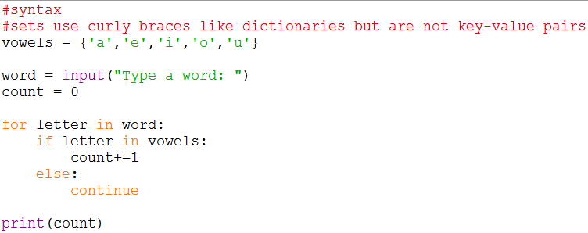
Sets for membership testing
They are most often used for membership testing and removing duplicates
Below program counts number of vowels in a word.
Notes:
#syntax
#sets use curly braces like dictionaries but are not key-value pairs
vowels = {'a','e','i','o','u'}
word = input("Type a word: ")
count = 0
for letter in word:
if letter in vowels:
count+=1
else:
continue
print(count)

Slide 4
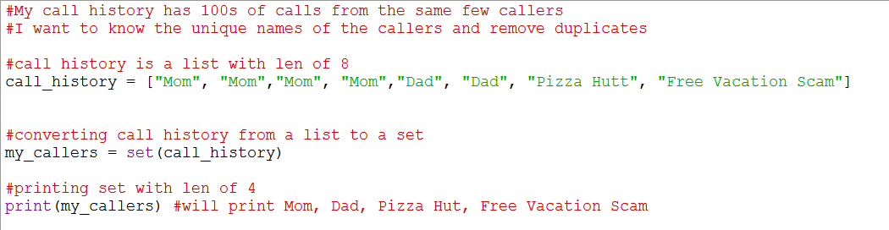
Sets for Removing duplicates
They are most often used for membership testing and removing duplicates
Below program removes duplicates in a list
Notes:
#My call history has 100s of calls from the same few callers
#I want to know the unique names of the callers and remove duplicates
#call history is a list with len of 8
call_history = ["Mom", "Mom","Mom", "Mom","Dad", "Dad", "Pizza Hutt", "Free Vacation Scam"]
#converting call history from a list to a set
my_callers = set(call_history)
#printing set with len of 4
print(my_callers)

Slide 5
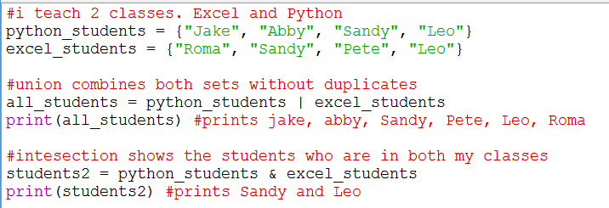
Set Notations
Notes:
#My call history has 100s of calls from the same few callers
#I want to know the unique names of the callers and remove duplicates
#call history is a list with len of 8
call_history = ["Mom", "Mom","Mom", "Mom","Dad", "Dad", "Pizza Hutt", "Free Vacation Scam"]
#converting call history from a list to a set
my_callers = set(call_history)
#printing set with len of 4
print(my_callers)

Slide 6
Review: Data Structures
Data Structure | Syntax | Ordered | Mutable | Allows duplicate values
List | l = [“eggs“, “milk”, “jello”] | Y | Y | Y
Tuple | t = (“eggs”, “milk”, “jello”) | Y | N | Y
Dictionary | d = {“eggs”:4, “milk”:2} | N | Y | Y*
Set | s = {“eggs”, “milk”, “jello”} | N | Y | N
Notes:
Review from powerpoint 2 slide 10

Slide 7
What you need to Memorize
How and/or when to
Printing to console, getting user input, storing variables, and basic math calculations
Write conditional statements
Converting data types and converting data structures
Create a list, dictionary, set, tuple and differences between them
Create functions
Error Handling
Create while and for loops
Import built-in modules, 3rd party modules, and your own modules
Common keywords like and, or, in, not in, continue, break,

Slide 8
Understand/Familiarize yourself with:
Installing 3rd party modules
Optional/default arguments in functions
List and dictionary methods
Functions and methods in modules
Concept of indexing and ranges
Optional/default arguments in functions
Comprehensions
Python website and documentations as well as other resources

Slide 9
Review Exercise:
Refactoring code is the common practice of re-writing code to increase its readability and efficiency without changing any of the programs functionality
Monty’s Bank asked you to refactor the following code. Use your knowledge of functions to remove redundancies and increase efficiency of this code.
Code is found in notes section
Notes:
###checking account setup
print(f"Lets set up your checking pin")
print(f"This account has a 1.0% APR")
print(f"Pin must be 8 digits")
print(f"Type 'skip' if you do not want to make this account \n")
checking_pin = None
while checking_pin != 'skip':
checking_pin = input(f"Enter your checking pin number: ")
if len(checking_pin) == 8:
print("Great. Your checking pin is set. \n")
break
else:
print("sorry try again")
continue
####savings account setup
print(f"Lets set up your savings pin")
print(f"This account has a 1.5% APR")
print(f"Pin must be 4 digits")
print(f"Type 'skip' if you do not want to make this account \n")
savings_pin = None
while savings_pin != 'skip':
savings_pin = input(f"Enter your checking pin number: ")
if len(savings_pin) == 4:
print("Great. Your checking pin is set. \n")
break
else:
print("sorry try again")
continue
####Certificate of Deposit account setup
print(f"Lets set up your Certificate of Deposit pin")
print(f"This account has a 2.5% APR")
print(f"Pin must be 4 digits")
print(f"Type 'skip' if you do not want to make this account \n")
cd_pin = None
while cd_pin != 'skip':
cd_pin = input(f"Enter your Certificate of Deposit pin number: ")
if len(cd_pin) == 4:
print("Great. Your Certificate of deposit pin is set. \n")
break
else:
print("sorry try again")
continue

Slide 10
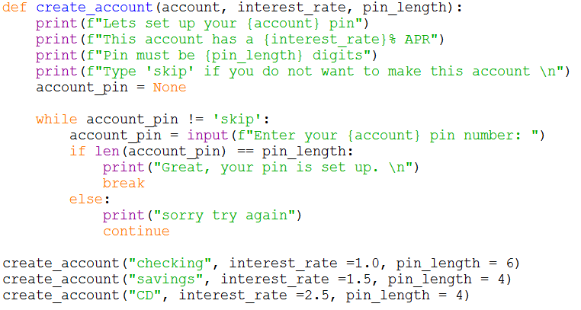
Review Exercise:
Notes:
def create_account(account, interest_rate, pin_length):
print(f"Lets set up your {account} pin")
print(f"This account has a {interest_rate}% APR")
print(f"Pin must be {pin_length} digits")
print(f"Type 'skip' if you do not want to make this account \n")
account_pin = None
while account_pin != 'skip':
account_pin = input(f"Enter your {account} pin number: ")
if len(account_pin) == pin_length:
print("Great. Your credit card pin is set. \n")
break
else:
print("sorry try again")
continue
create_account("checking", interest_rate =1.0, pin_length = 6)
create_account("savings", interest_rate =1.5, pin_length = 4)
create_account("CD", interest_rate =2.5, pin_length = 4)

Slide 11
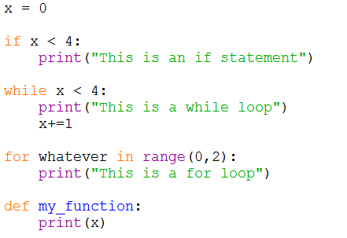
Syntax Review

Slide 12
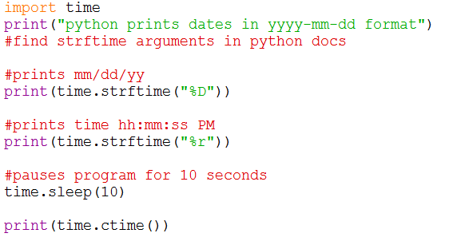
Time Library Methods
The time library allows you to work dates and times
A module is a file containing code (statements, functions, etc) which you can re-use.
You can also import your own files as modules
Notes:
import time
print("python prints dates in yyyy-mm-dd format")
#find strftime arguments in python docs
#prints mm/dd/yy
print(time.strftime("%D"))
#prints time hh:mm:ss PM
print(time.strftime("%r"))
#pauses program for 10 seconds
time.sleep(10)
print(time.ctime())

Slide 13
Importing Your own files
You can import pre-built libraries like time and random or you can install 3rd party libraries like
See Python directory in IDE or Python website for full list of methods and arguments
Notes:
import time
print("python prints dates in yyyy-mm-dd format")
#find strftime arguments in python docs
#prints mm/dd/yy
print(time.strftime("%D"))
#prints time hh:mm:ss PM
print(time.strftime("%r"))
#pauses program for 10 seconds
time.sleep(10)
print(time.ctime())

Slide 14
Reading Files
Python allows you to read and write to files without modules
Importing modules such as csv and pandas grants you additional functionality and conveniences

Slide 15
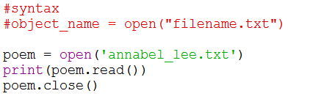
Reading Files
The open function opens a file.
The first argument is the file name or path and it is required.
The second argument is optional and will be the mode (read, write, append)
If a second argument is not selected, it will be default to read only

Slide 16
File Modes
Mode (Second Argument) | Access Level | Clear/Overwrite file | Position in file | Create File if Does not exist
r | read only | No | Beginning | No
r+ | Read and write | No | Beginning | Yes
w | Write only | Yes | Beginning | Yes
w+ | Read and write | Yes | Beginning | Yes
a | Write only | No | End | Yes
a+ | Read and write | No | End | Yes

Slide 17
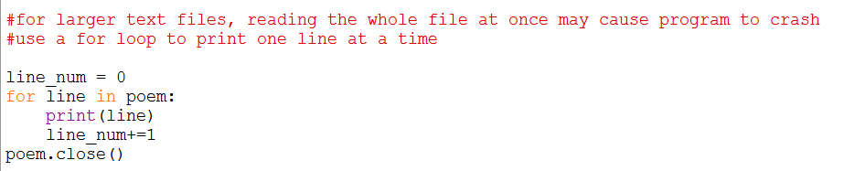
Reading Files
Lets read the email trail file

Slide 18
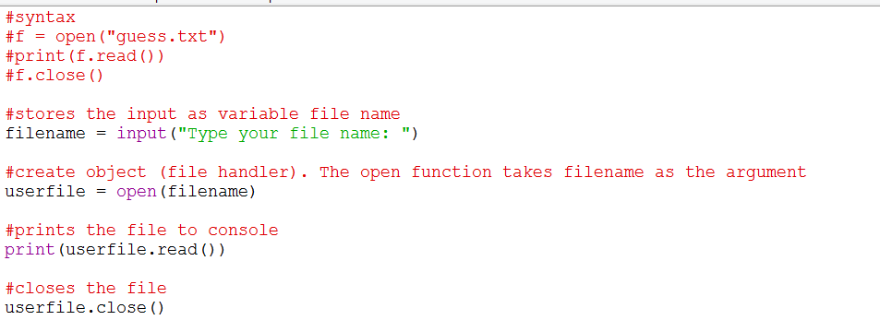
Exercise #2
Ask user to enter the file name they want to read. (use various sized files)
Print the file to the user
Notes:
#syntax
#f = open("guess.txt")
#print(f.read())
#f.close()
#stores the input as variable file name
filename = input("Type your file name: ")
#create object (file handler). The open function takes filename as the argument
userfile = open(filename)
#prints the file to console
print(userfile.read())
#closes the file
userfile.close()

Slide 19
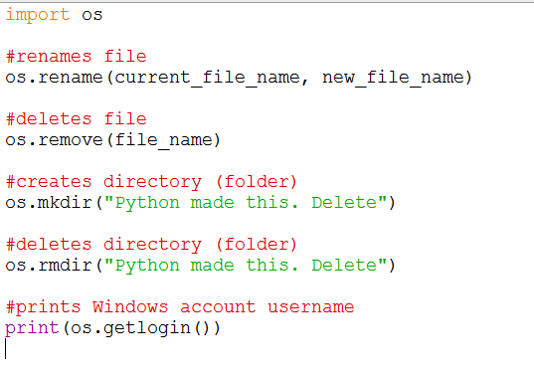
OS Library Methods
The os library allows you to read, write, copy, move, rename etc. with files in your system.
Full list of methods is available on the Python website or OS directory

Slide 20
File and String functions/methods
 | Purpose | Input | Syntax | Output
.upper() | Converts to Upper Case | name = “Monty” | name.upper() | MONTY
.lower() | Converts to lower case | name = “Monty” | name.lower() | monty
.title() | Converts to Title case | name = “monty” | name.title() | Monty
.replace() | Replaces parts of a string | s = “I like my dogs” | s.replace(“like”,”love”) | I love my dogs
.split() | Splits | name = “Monty Python” | name.split() | [‘Monty’] , [‘Python’]
len() | Finds length | name = “monty” | len(name) | 5
Python is case sensitive. “Monty” != “MONTY”

Slide 21
Exercise #2
Open the file birthday song or use any text file you would like
Requirements:
Open the file in read only mode. If the file does not exist, print a friendly error message
Print happy birthday to the user. Replace “user” in file with the actual name. You can either ask for user to input their name or use the Computer Account Name
Convert each line to all caps
Print the total number of lines at the end of the file
Notes:
import random
coin = ["heads", "tails"]
times_played = 0
times_correct = 0
while True:
flip = random.choice(coin)
guess = input("Heads or tails? ".lower())
if flip == guess:
print("you win")
flip = random.choice(coin)
times_played +=1
times_correct +=1
score = round((times_correct/times_played)*100,1)
print(f"Correct. You have {score}% accuracy")
else:
times_played+=1
score = round((times_correct/times_played)*100,1)
print(f"Incorrect. You have {score} % accuracy")
flip = random.choice(coin)

Slide 22
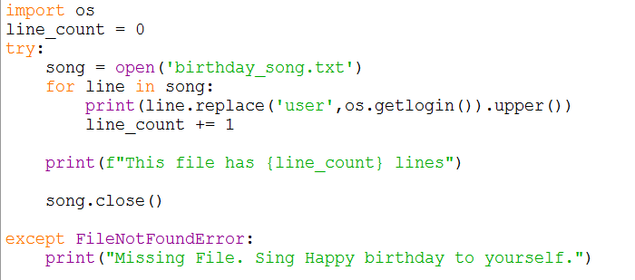
Exercise #2
Notes:
import os
line_count = 0
try:
song = open('birthday_song.txt')
for line in song:
print(line.replace('user',os.getlogin()).upper())
line_count += 1
print(f"This file has {line_count} lines")
song.close()
except FileNotFoundError:
print("Missing File. Sing Happy birthday to yourself.")

Slide 23
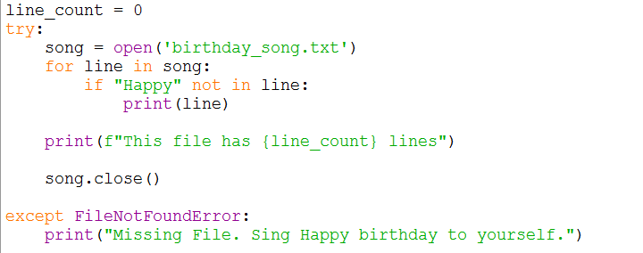
Membership Testing

Slide 24
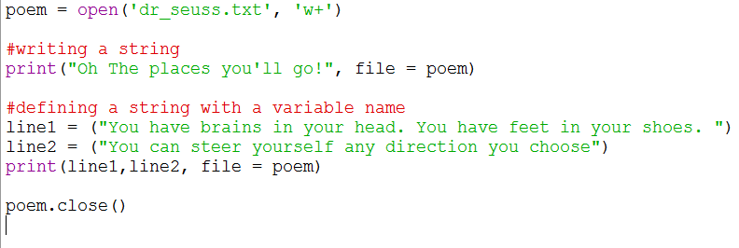
Writing Files with Print
Notes:
poem = open('dr_seuss.txt', 'w+')
#writing a string
print("Oh The places you'll go!", file = poem)
#defining a string with a variable name
line1 = ("You have brains in your head. You have feet in your shoes. ")
line2 = ("You can steer yourself any direction you choose")
print(line1,line2, file = poem)
poem.close()

Slide 25
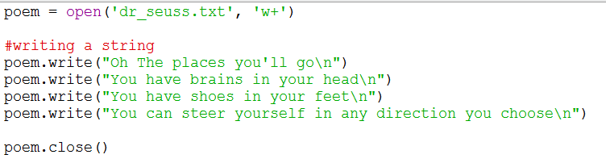
Writing Files
To read a file, we can use objectname.read() or readlines()
To write a file, we use objectname.write() or writelines()
Notes:
poem = open('dr_seuss.txt', 'w+')
#writing a string
poem.writelines("Oh The places you'll go\n")
poem.writelines("You have brains in your head\n")
poem.writelines("You have shoes in your feet\n")
poem.writelines("You can steer yourself in any direction you choose\n")
poem.close()

Slide 26
Exercise #3
Below code is a game that flips a coin and lets user guess Heads or tails
Requirements:
Write to a file the following information separated by commas. player name, score, and date and time of the coin flip
If user types in “end”, quit the game
If the file was deleted, moved, renamed, etc, then create a new one.
Notes:
import random
coin = ["heads", "tails"]
times_played = 0
times_correct = 0
while True:
flip = random.choice(coin)
guess = input("Heads or tails? ".lower())
if flip == guess:
print("you win")
flip = random.choice(coin)
times_played +=1
times_correct +=1
score = round((times_correct/times_played)*100,1)
print(f"Correct. You have {score}% accuracy")
else:
times_played+=1
score = round((times_correct/times_played)*100,1)
print(f"Incorrect. You have {score} % accuracy")
flip = random.choice(coin)

Slide 27
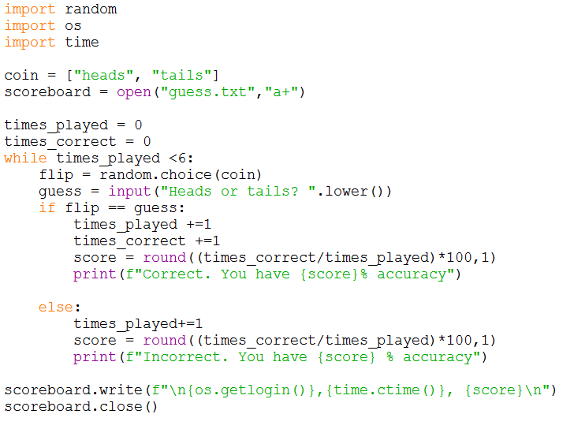
Notes:
import random
import os
import time
coin = ["heads", "tails"]
scoreboard = open("guess.txt","a+")
times_played = 0
times_correct = 0
while times_played <6:
flip = random.choice(coin)
guess = input("Heads or tails? ".lower())
if flip == guess:
times_played +=1
times_correct +=1
score = round((times_correct/times_played)*100,1)
print(f"Correct. You have {score}% accuracy")
else:
times_played+=1
score = round((times_correct/times_played)*100,1)
print(f"Incorrect. You have {score} % accuracy")
scoreboard.write(f"\n{os.getlogin()},{time.ctime()}, {score}\n")
scoreboard.close()

Slide 28
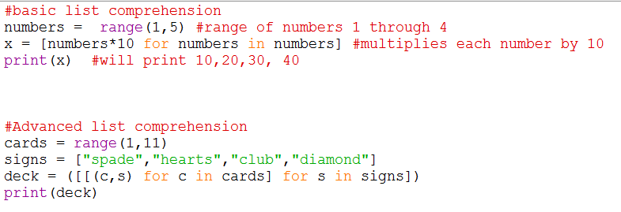
Comprehensions
You can do comprehensions on lists, tuples, dictionaries, sets and other data structures
Notes:
Review from powerpoint 2 slide 10

